Slide 1




Uncertainty Quantification in Hypersonic Simulations

Slide 2
Forrest Mobley
Aerospace Engineering
mobleyf@my.erau.edu
Mentored by
Dr. Shigeo Hayashibara
College of Engineering
ERAU
In Association with
Seth Lawrence and Dr. Earl Duque
Intelligent Light

Slide 3
Uncertainty Quantification
Besides the validation and verification processes, Computational Fluid Dynamics (CFD) simulations have limitations in numerical accuracy
Contributors include discretization, inputs, and turbulence models used
The uncertainty quantification (UQ) process of these contributors is still under development
Purpose of this work is to help develop this process by performing and documenting the analysis of discretization and input uncertainty
Notes:
Applying Paradrogue Tech to UAVs, and increasing stability

Slide 4
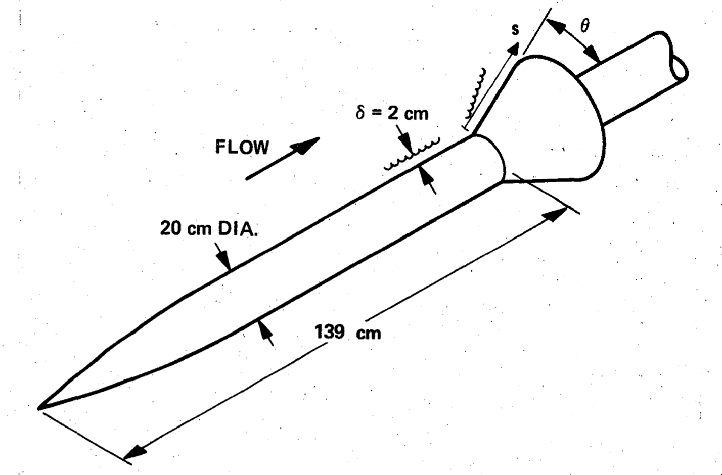
Project Overview
Developed a set of CFD simulations based on experimental data [1]
Discretization uncertainty was estimated by comparing how different grids behaved
Input uncertainty was estimated by analyzing the behavior of simulation output based on certain inputs
Ogive Cylinder Experimental Test Model Diagram [1]
Notes:
Helicopter Video

Slide 5
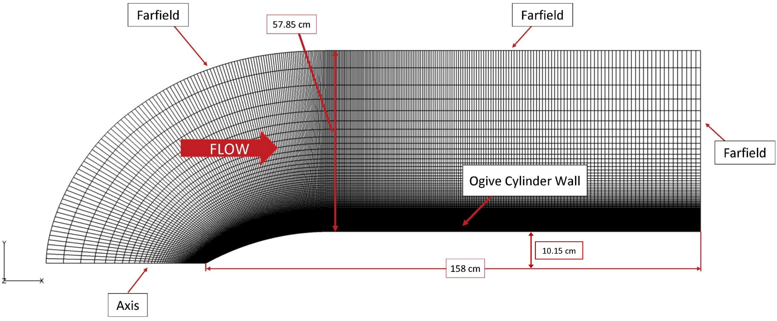
Simulation Setup
CFD Software: GenesisCFD
Turbulence Model: Spalart-Allmaras 1-equation
Boundary Conditions:
Farfield
Ogive Cylinder No Slip Wall
Axis: 2D grid rotated 5° (1 cell width)
Initial Conditions:
Farfield:
Mach 7.05
P₀ = 576 Pa
T₀ = 81.2 K
Ogive Wall:
311 K (Isothermal)
Ogive Cylinder “Fine” Grid

Slide 6
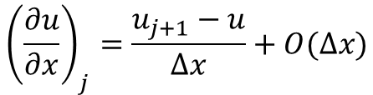
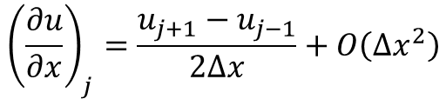
Discretization Uncertainty
PDE -> Algebraic Expression incurs error in the form of Higher Order Terms (HOTs) (error term)
The lowest power HOT gives the theoretical “order of accuracy” (OA) of the method (higher power = higher accuracy)
True or observed order of accuracy may differ; to find this, several grids are made, simulated, and compared [2]
Central Differencing Method
$${\left(\frac{∂u}{∂x}\right)}_{j}=\frac{u_{j+1}−u_{j−1}}{2Δx}+O\left(Δx^{2}\right)$$
2nd Order HOT
Forward Differencing Method
$${\left(\frac{∂u}{∂x}\right)}_{j}=\frac{u_{j+1}−u}{Δx}+O(Δx)$$
1st Order HOT

Slide 7
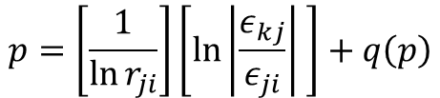




Discretization Uncertainty
Define representative grid size h_{i} corresponding to each mesh (the cell count)
Define a grid refinement factor r as a ratio of h values:
Calculate the observed OA p: where or the difference in output Qualities of Interest (Axial Force). Note q = 0 if all r are equal
Calculate approximate relative error e and Grid Convergence Index (GCI):
All from [2]
$$r_{ji}=\frac{h_{j}}{h_{i}}>1$$
$$p=\left[\frac{1}{\ln{r_{ji}}}\right]\left[\ln\left|\frac{ε_{kj}}{ε_{ji}}\right| \right]+q\left(p\right)$$
$$ε_{ji}=φ_{j}−φ_{i}$$
$$e_{a}^{ji}=\left|φ_{ji}−φ_{ji}\right|$$
$${GCI}^{ji}=\frac{F_{s}∗e_{a}^{ji}}{r_{ji}−1}$$
Grid | Xcoarse (1) | Coarse (2) | Medium (3) | Fine (3) | Xfine (5)
Cell Count (N) | 1287 | 5372 | 21942 | 88682 | 356562
QoI (Newtons) | 1.7898836 | 1.82927604 | 1.85312439 | 1.86347909 | 1.8941726

Slide 8
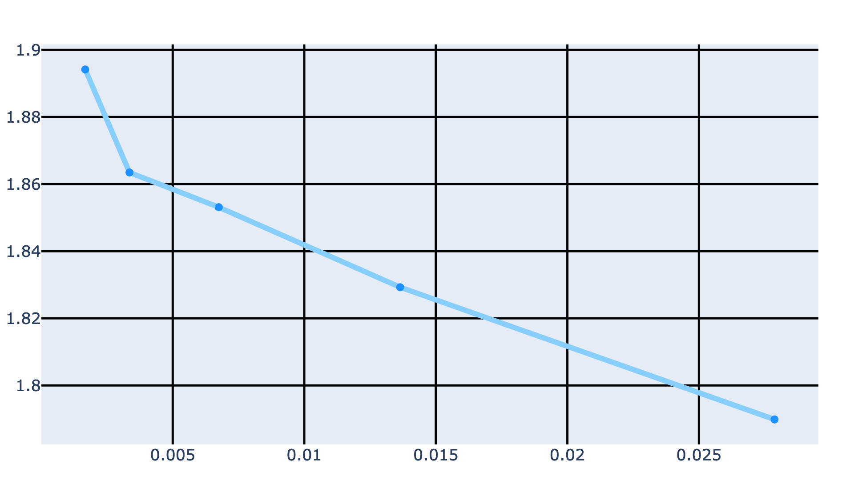


Discretization Uncertainty
Axial Drag Force Behavior
Limitations of this method:
Assumes a uniform grid
Requires an equal grid refinement factor for every grid
Assumes that QoI (φ) is in the “asymptotic range”
Indication of Nonconvergence
5
4
3
$$ϕ\left(N\right)$$
2
Beginnings of Asymptotic Behavior
1
$$\frac{1}{\sqrt{N}}$$
Grid | φ (Newtons) | 1/(N^1/2) | p (OA) | e (Newtons) | GCI (%)
Xcoarse | 1.7898836 | 0.02787473 | - | - | -
Coarse | 1.82927604 | 0.01364369 | 0.71327183 | 0.03939244 | 4.72082923
Medium | 1.85312439 | 0.0067509 | 1.19467572 | 0.02384835 | 2.919679
Fine | 1.86347909 | 0.00335801 | -1.56183804 | 0.0103547 | 1.28103162
Xfine | 1.8941726 | 0.00167468 | - | 0.03069351 | 3.8169798

Slide 9
Input Uncertainty
Mach | Wall Temp. (K)
7.079822 | 306.483549
6.995174 | 313.681979
7.277504 | 309.073453
7.161273 | 311.497217
6.794919 | 308.149887
7.231589 | 313.358689
7.151515 | 311.078160
6.932725 | 312.242420
7.041992 | 310.343391
6.883619 | 306.029190
6.975328 | 308.580596
7.114380 | 309.639426
Input Uncertainty comes from the freestream conditions imposed on the simulation
To quantify this, uncertain inputs are determined and sets of values for these inputs are generated and tested (number of samples was determined using point-collocated non-intrusive polynomial chaos (NIPC))
Once the data has been generated, uncertainties and contributions of each uncertain input can be estimated [3]
In this case, Mach and Wall Temperature value sets were generated using Latin Hypercube sampling [4], and the QoI was Axial Force. All simulations were completed with the “Fine” grid

Slide 10
Input Uncertainty
NIPC also creates a surrogate model (prediction surface) based on this data, and this is used to estimate uncertainty intervals in the QoI
Using the mean of the axial force, Sobol indices were derived using this surrogate model, based on the steps in [5]
Sobol indices, which range from 0 to 1, give an indication of how much a parameter contributed to the change in an output
As might be expected, in this case Mach dominated contributions
However, Wall Temp. saw a 2 order-of-magnitude increase in contribution when axial force due to viscous effects was isolated
Input | Total Axial Force | Axial Pressure Force | Axial Viscous Force
Mach | 0.9999 | 0.9999 | 0.9969
Wall Temperature | 2.3811e-5 | 4.0709e-5 | 3.1179e-3
Uncertainty Intervals (95%) (N) | 1.7219 – 2.0108 | 1.4062 – 1.6468 | 0.31564 – 0.36409

Slide 11
Total Uncertainty
With the linear combination of the mean discretization uncertainty (GCI) and the input uncertainty (surrogate model), the total uncertainty was found
Uncertainty due to the turbulence model can also be found using the same method as with input uncertainty, but was not performed as it was out of scope
For this case, uncertainty in the total axial force was conservatively estimated at ±0.35259, or approximately 19% of the mean
Uncertainty Type | Discretization | Input | Total Uncertainty
Interval Width (Newtons) | ±0.06369 | ±0.2889 | 1.86577 ± 0.35259

Slide 12
Conclusions & Future Work
Conclusion | Future Work
CFD Uncertainty Quantification can be nebulous and difficult to complete correctly | Defining a standardized method for the entire CFD community. This work was part of Intelligent Light’s ongoing effort on this matter
Even if followed correctly, the procedures are not guaranteed to apply correctly and are open to interpretation

Slide 13
Questions

Slide 14
[1] Kussoy, M.I. & Horstman CC, “Documentation of Two- and Three-Dimensional Shock Wave/Turbulent Boundary Layer Interaction Flows,” NASA TM 103838, 1991.
[2] ASME V&V 20-2009, “Standard for Verification and Validation in Computational Fluid Dynamics and Heat Transfer,“ The American Society of Mechanical Engineers, 2009, ISBN: 9780791832097.
[3] Cary, A.W.; , Duque, E.P.N., Lawrence, S.S., & Schaefer, J.A., “Application of a CFD Uncertainty Quantification Framework for Industrial-Scale Aerodynamic Analysis,” AIAA 2019-1492.
[4] Helton, J.C. & Davis, F.J., “Latin Hypercube Sampling and the Propagation of Uncertainty in Analyses of Complex Systems,” Reliability Engineering & System Safety, Volume 81, Issue 1, 2003, Pages 23-69, ISSN 0951-8320, https://doi.org/10.1016/S0951-8320(03)00058-9.
[5] Ghaffari, S., Iaccarino, G., & Magin, T., “Uncertainty Quantification of Radiative Heat Flux Modeling for Titan Atmospheric Entry,” AIAA 2010-239.

